Slide 1
Sales Performance Dashboard Analysis
Business Insights Using Microsoft Excel
Presented by:
SADHANA RAJAK
Tools Used:
Microsoft Excel | Pivot Tables | Dashboard Visualization

Slide 2
Project Objective
The objective of this project is to analyze company sales performance using Microsoft Excel dashboards and identify business trends related to revenue, products, regions, customer behavior, and sales channels.
The dashboard helps transform raw sales data into meaningful business insights to support data-driven decision-making.

Slide 3
Dataset Overview
The dataset contains sales transaction details including:
Sales Amount
Orders
Product IDs
Product Categories
Sales Regions
Sales Channels
Quantity Sold
Sales Representatives
Customer Types
Payment Methods
Tools Used
Microsoft Excel
Pivot Tables
Pivot Charts
Dashboard Design
Data Visualization

Slide 4
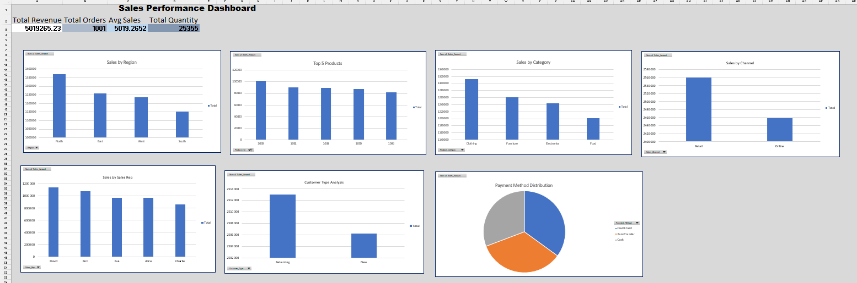
Dashboard Overview
The dashboard provides a visual representation of company sales performance through KPI metrics, sales comparisons, product analysis, customer behavior analysis, and payment distribution insights.

Slide 5
Analysis Performed
The following analysis was performed:
Total Revenue Analysis
Total Orders Analysis
Average Sales Calculation
Sales by Region
Top Performing Products
Sales by Category
Sales by Sales Channel
Sales Representative Performance
Customer Type Analysis
Payment Method Distribution

Slide 6
Key Business Insights
The North region generated the highest sales revenue.
Product 1009 was identified as the top-performing product.
Returning customers contributed more revenue compared to new customers.
Sales representatives showed varying levels of performance.
Payment methods were distributed almost evenly across customers.
Some product categories contributed significantly more revenue than others.
Customer purchasing behavior differed across sales channels.

Slide 7
Statistical Validation
Null Hypothesis (H₀):
There is no significant difference in sales performance between regions.
Alternative Hypothesis (H₁):
There is a significant difference in sales performance between regions.
A basic statistical comparison was performed to analyze sales variation across regions. The findings suggest noticeable differences in regional sales performance, highlighting the need for region-specific business strategies.
p<0.05
Values below 0.05 are considered statistically significant.

Slide 8
Business Recommendations
Increase marketing efforts in high-performing regions.
Improve strategies in underperforming regions.
Reward top-performing sales representatives.
Develop customer retention strategies for returning customers.
Optimize payment options for better customer convenience.
Maintain inventory for high-demand products and categories.

Slide 9
Conclusion
This project successfully transformed raw sales data into meaningful business insights using Microsoft Excel dashboard visualization techniques.
The analysis supports better decision-making related to sales strategy, customer behavior, regional performance, and product management.

